Slide 1
Reading Asia welcoming award-winning children’s literature into your classrooms.
Luciano Marzulli
K-16 Outreach Coordinator

Slide 2
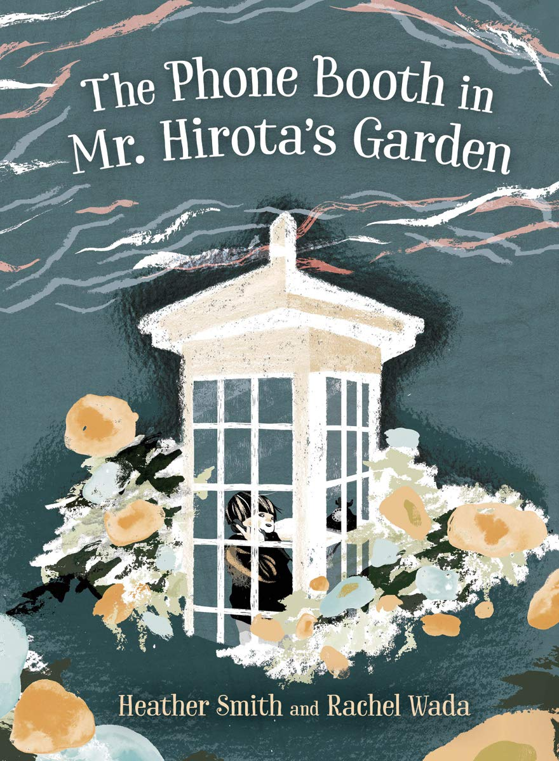
This session will provide an opportunity to take an in depth look at the 2019 Freeman Book Award Winner: The Phone Booth in Mr. Hirota’s Garden by Heather T. Smith illustrated by Rachel Wada.
Notes:
My intro-who am I and what do I do
Who is in the room?
Poll in zoom:
Have you ever used a phone booth? When was the last time you saw or used a phone booth?

Slide 3
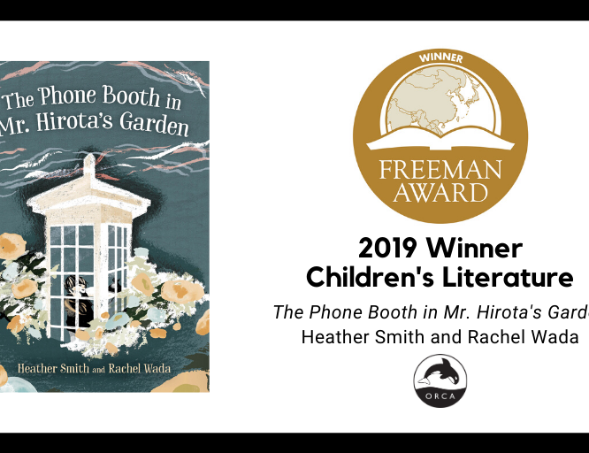
Freeman Book Awards
Honoring East And Southeast Asian Titles for Children and Young Adults
The National Consortium for Teaching about Asia (NCTA), the Committee on Teaching about Asia (CTA) of the Association for Asian Studies (AAS), and Asia for Educators (AFE) at Columbia University sponsor the annual Freeman Book Awards for new young adult and children’s literature. The awards recognize quality books for children and young adults that contribute meaningfully to an understanding of East and Southeast Asia. Awards are given in two categories: Children’s and Young Adult on the several countries of East and Southeast Asia.

Slide 4
The Phone Booth in Mr. Hirota's garden
By Heather Smith
Illustrated by Rachel Wada
Maiko and Mr. Hirota are neighbors. A tsunami destroys the harbor where they live and kills Maiko's father and Mr. Hirota's daughter along with many people in their village. Maiko stops talking. Mr. Hirota builds a phone booth and talks to his dead daughter. Maiko hears him and eventually goes to the phone booth to speak to his dad. Many other villagers visit the phone booth to speak with their lost relatives too. Based on the true story of Itaru Sasaki and the wind phone he built.
Notes:
Maiko and Mr. Hirota are neighbors. A tsunami destroys the harbor where they live and kills Maiko's father and Mr. Hirota's daughter along with many people in their village. Maiko stops talking. Mr. Hirota builds a phone booth and talks to his dead daughter. Maiko hears him and eventually goes to the phone booth to speak to his dad. Many other villagers visit the phone booth to speak with their lost relative too. Based on the true story of Itaru Sasaki and the wind phone he built.

Slide 5
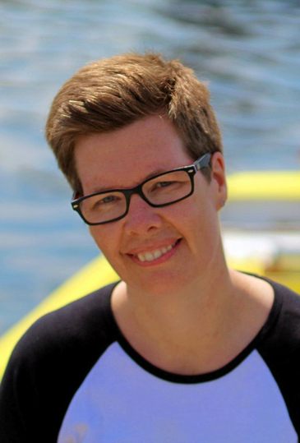
Heather Smith
Originally from Newfoundland, Heather Smith now lives in Waterloo, Ontario, with her family. Her Newfoundland roots inspire much of her writing. Her middle-grade novel Ebb and Flow was short-listed for the Governor General's Literary Award, and her YA novel The Agony of Bun O'Keefe won the Ruth and Sylvia Schwartz Children's Book Award and was short-listed for the Amy Mathers Teen Book Award and the Geoffrey Bilson Award for Historical Fiction for Young People. For more information, visit heathertsmith.com.
Notes:
Originally from Newfoundland, Heather Smith now lives in Waterloo, Ontario, with her family. Her Newfoundland roots inspire much of her writing. Her middle-grade novel Ebb and Flow was short-listed for the Governor General's Literary Award, and her YA novel The Agony of Bun O'Keefe won the Ruth and Sylvia Schwartz Children's Book Award and was short-listed for the Amy Mathers Teen Book Award and the Geoffrey Bilson Award for Historical Fiction for Young People. For more information, visit heathertsmith.com.

Slide 6
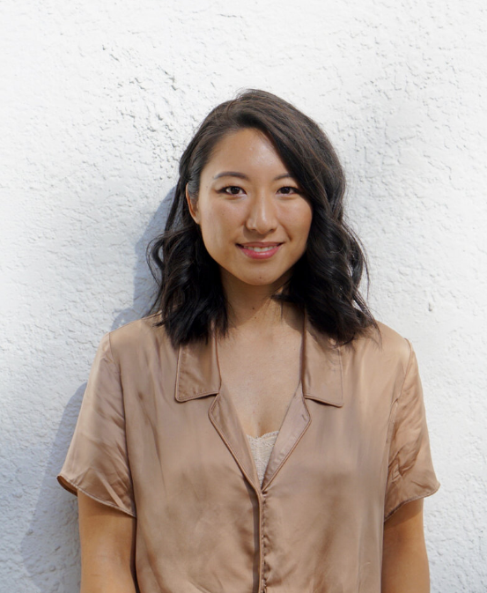
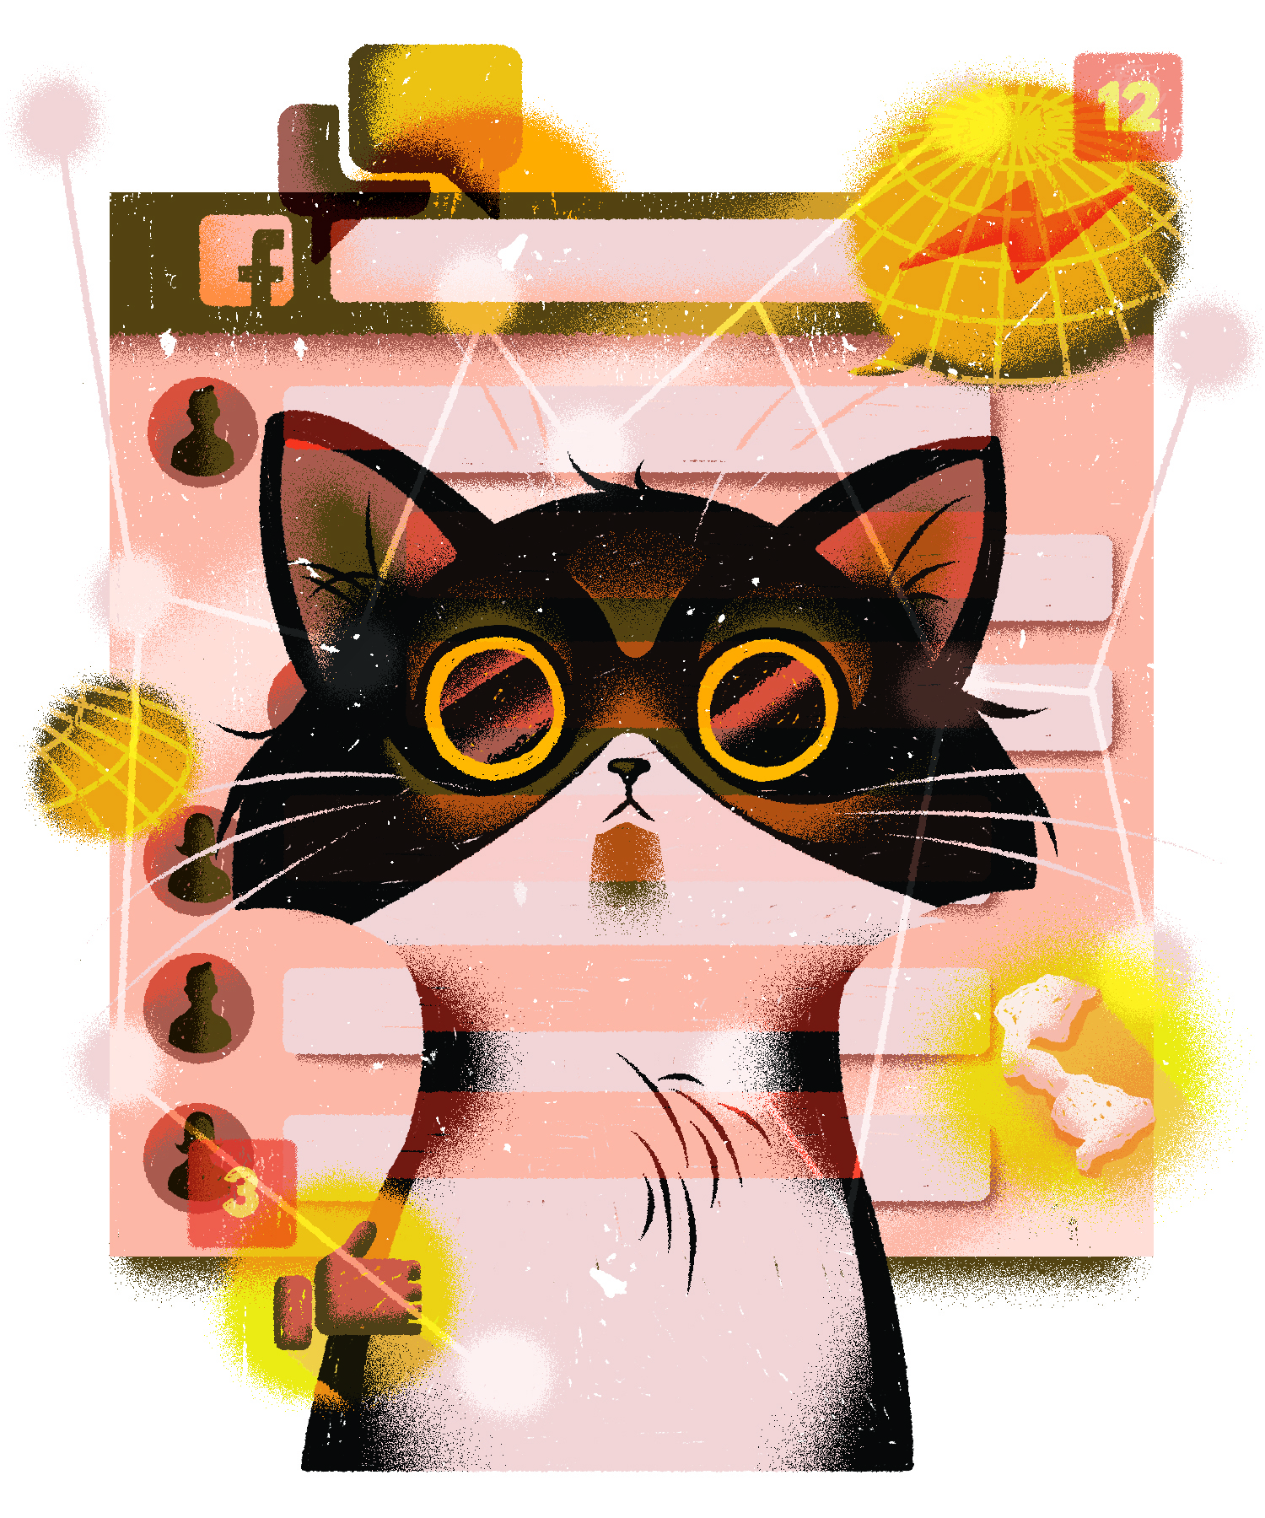
Rachel Wada
Rachel Wada is a freelance illustrator whose work is defined by heavy texture, bold color and intricate details that capture the nuances of people, places and ideas, real and surreal. Rachel's identity as Japanese-Cantonese, an immigrant and a woman informs her artistic practice. She loves to put her own spin on traditional techniques, motifs and symbolism inspired by her cultural background. This duality of old and new is also apparent in her use of both traditional and digital mediums, and she draws inspiration from a variety of sources, from Japanese woodblock prints, Chinese pottery and ceramics, food packaging design to traditional folk art. She has a special love for the ocean, tea and noodles of all kinds. Rachel lives in Vancouver, British Columbia. For more information, visit rachelwada.com.
Notes:
Rachel Wada is a freelance illustrator whose work is defined by heavy texture, bold color and intricate details that capture the nuances of people, places and ideas, real and surreal. Rachel's identity as Japanese-Cantonese, an immigrant and a woman informs her artistic practice. She loves to put her own spin on traditional techniques, motifs and symbolism inspired by her cultural background. This duality of old and new is also apparent in her use of both traditional and digital mediums, and she draws inspiration from a variety of sources, from Japanese woodblock prints, Chinese pottery and ceramics, food packaging design to traditional folk art. She has a special love for the ocean, tea and noodles of all kinds. Rachel lives in Vancouver, British Columbia. For more information, visit rachelwada.com.

Slide 7
Let’s Read!
Uplift At Home: Teresa Reads "The Phone Booth in Mr. Hirota's Garden"
https://www.youtube.com/watch?v=AX_I1C6NP5s
Notes:
Scribd link to title: https://www.scribd.com/book/421340480/The-Phone-Booth-in-Mr-Hirota-s-Garden
Uplift At Home: Teresa Reads "The Phone Booth in Mr. Hirota's Garden"
https://www.youtube.com/watch?v=AX_I1C6NP5s

Slide 8
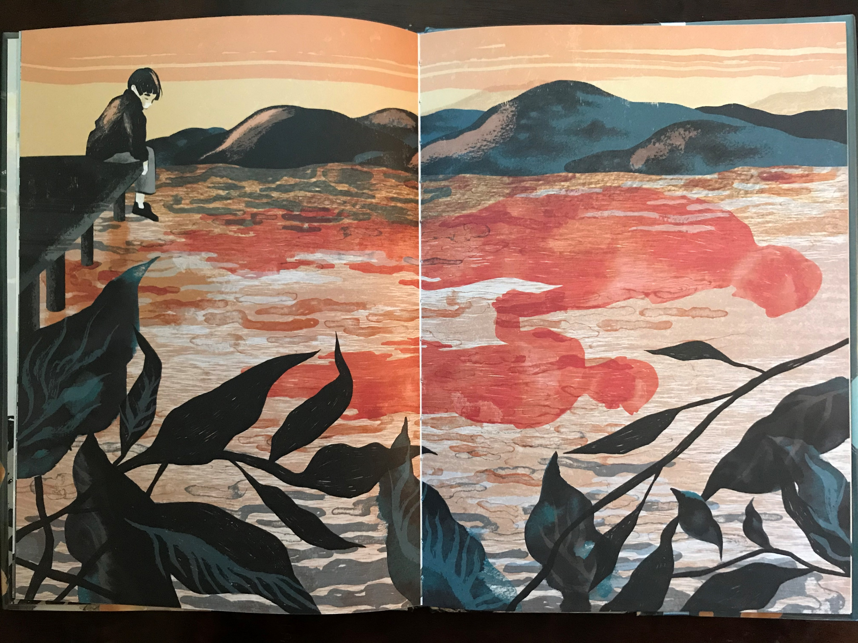
Additional Readings & resource links…
NPRs This American Life story about Itaru Sasaki and the real wind phone: https://www.thisamericanlife.org/597/one-last-thing-before-i-go-2016
The Phone Booth for Japanese Mourners on Bloomberg: https://www.bloomberg.com/news/articles/2017-01-10/japan-s-wind-phone-is-a-site-to-mediate-on-life-and-loss

Slide 9
Freeman Book Awards Resources
http://nctasia.org/resources/

Slide 10
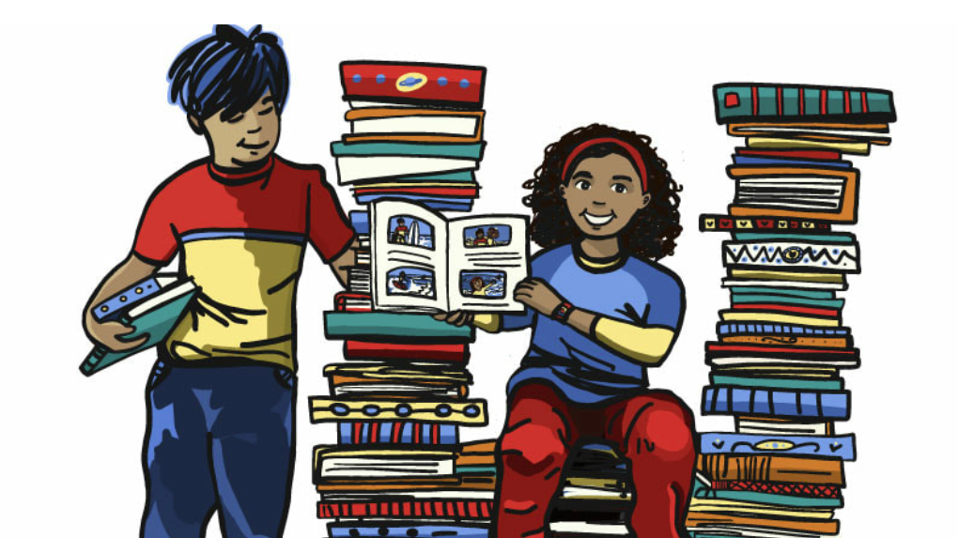
READ U
Curated book sets through the College of Education:
http://readu.utah.edu

Slide 11
Let’s work together!
Luciano Marzulli
l.marzulli@utah.edu
K-16 Outreach Coordinator
International and Area Studies
801.581.6518
http://ias.utah.edu
Notes:
List servs
In services with districts or schools

